Slide 1
BUILDING YOUR FIRST NEURAL NETWORK

Slide 2
AGENDA
Re-cap of machine learning
Neural networks overview
Training NOT function
Training OR/AND function
Training XOR function
Training a digit classifier

Slide 3
MACHINE LEARNING
Definition
“A computer program is said to learn from experience E with respect to some class of tasks T and performance measure P if its performance at tasks in T, as measured by P, improves with experience E.”
- Tom M. Mitchell
Examples
Task T | Performance Measure P | Experience E
Optical character recognition | Fraction of characters accurately recognized | Training on labeled characters
Spam filtering | Accurately tagging spam and not tagging non-spam | Training on emails labelled as spam/non-spam

Slide 4
NEURAL NETWORKS
Systems inspired by the biological brain
Represented by neurons connected together in a network
Learns by adjusting the strength of connections between neurons

Slide 5
NEURAL NETWORKS
Neurons
Building blocks of biological brains
Takes multiple inputs, processes them and produces single output
Adjusting connection strengths and connecting to different neurons help us learn

Slide 6
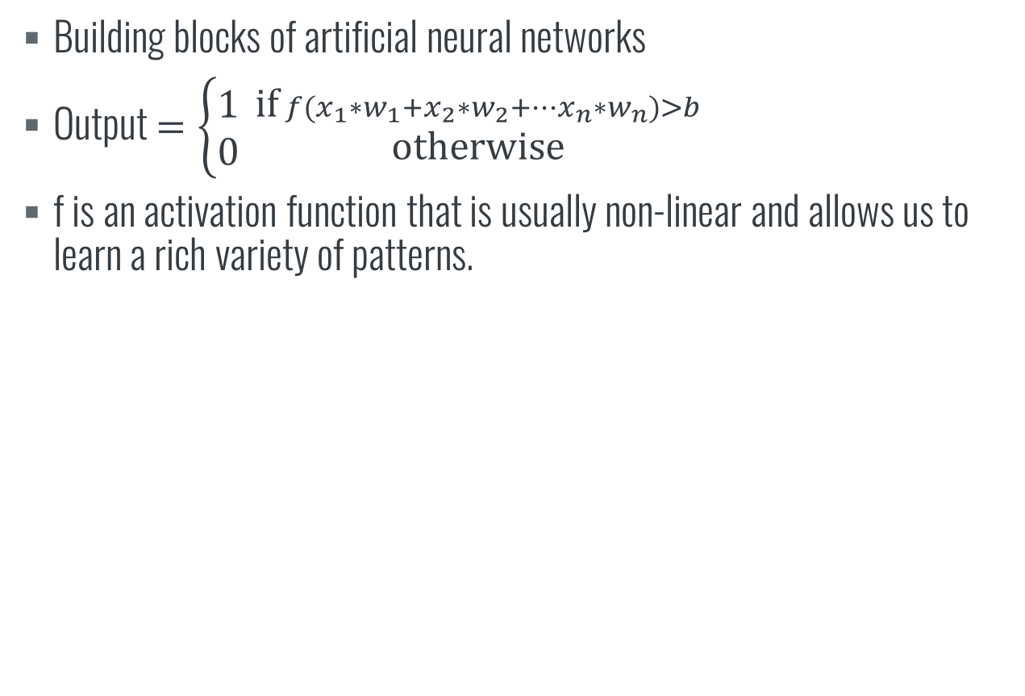
NEURAL NETWORKS
Artificial Neurons
Building blocks of artificial neural networks
Output $=\left\{\begin{aligned}1 \\ 0\end{aligned}\right. {\text{if} {f(x}_{1}∗w_{1}+x_{2}∗w_{2}+…x_{n}∗w_{n})>b \atop \text{otherwise}}$
f is an activation function that is usually non-linear and allows us to learn a rich variety of patterns.

Slide 7
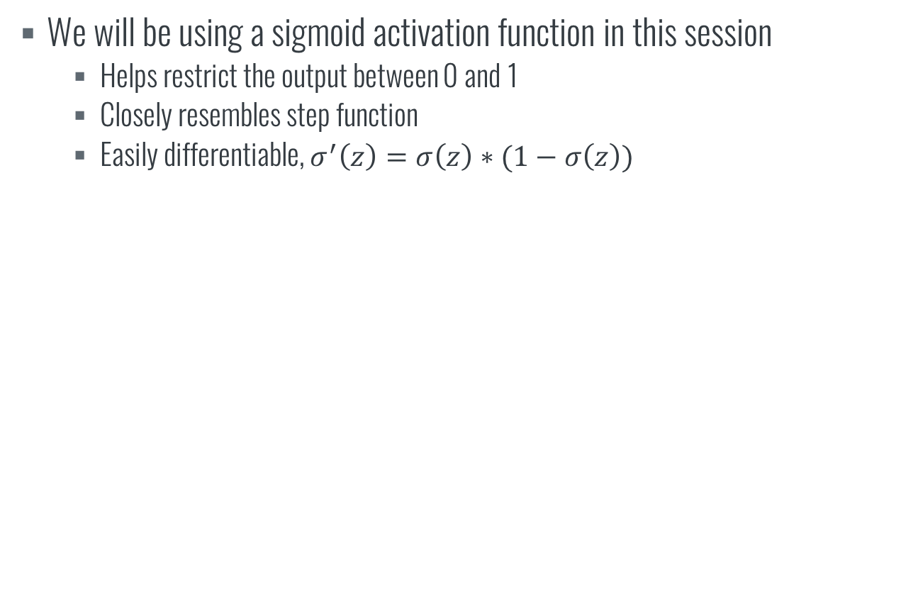
NEURAL NETWORKS
Activation function
We will be using a sigmoid activation function in this session
Helps restrict the output between 0 and 1
Closely resembles step function
Easily differentiable, $σ^{′}\left(z\right)=σ\left(z\right)∗(1−σ\left(z\right))$

Slide 8
NEURAL NETWORKS
Training
By training a neural network, we aim to compute a set of weights and biases that gives the output we want
Achieved using a technique called gradient descent. We start with a random set of weights and biases and adjust them along the gradient to reduce some cost function.

Slide 9
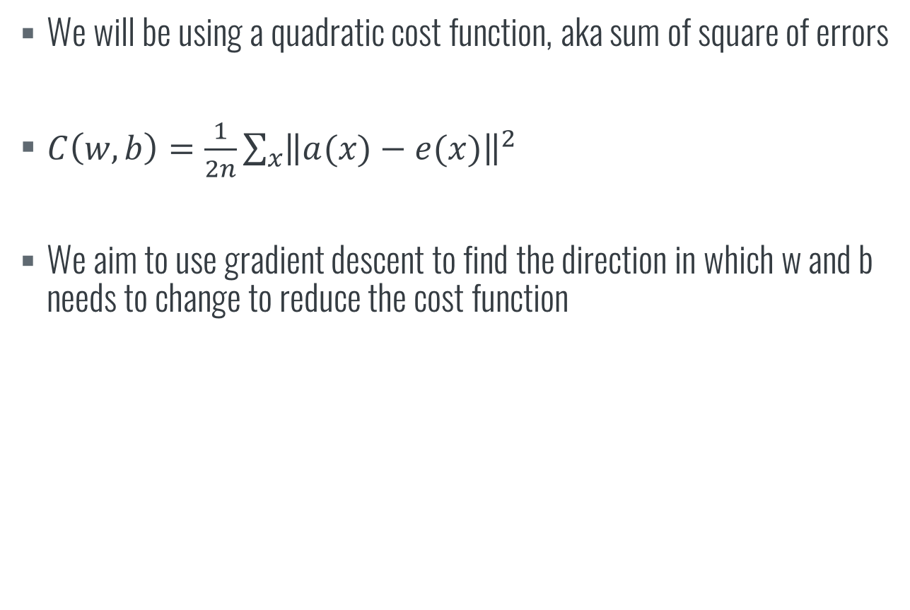
NEURAL NETWORKS
Cost function
We will be using a quadratic cost function, aka sum of square of errors
$C\left(w,b\right)=\frac{1}{2n}\sum_{x}{{\left\|a(x)−e(x)\right\|}^{2}}$
We aim to use gradient descent to find the direction in which w and b needs to change to reduce the cost function

